Slide 1
Enhanced Road Detection System
Department of Computer Science
T.Y.B.Sc.(Computer Science)
Sir Parashurambhau College (Autonomous) Pune,
2023-24

Slide 2
Project Group Members
Project Team –
Project Guide -
Mrs. Renuka Lakhangaonkar
Sr No | Name | Roll Number | Seat Number | Role
1 | Saniya Salunkhe | 4210115 | SP04210115 | Lane Detection
2 | Divya Pansare | 4210090 | SP04210090 | Pothole Detection
3 | Shraddha Pansare | 4210092 | SP04210092 | Zebra & Signal Detection

Slide 3
Introduction
Enhanced Road Detection is a big step forward for making roads safer and managing traffic better. With today's roads getting more complicated and crowded, there's a growing need for smart systems to spot things on the road.
At its core, this system utilizes sophisticated computer vision techniques like object detection and image analysis, leveraging YOLO for real-time detection of road features, thereby enhancing driving safety.
It's main job is to find lane lines and keep cars in their lanes to prevent accidents. It also looks out for dangers like potholes and warns drivers about them early to avoid accidents.
Also, it's smart enough to spot crossings and traffic lights, making intersections safer. Though it may not be perfect all the time, it tries its best to find important things on the road, making driving safer and smoother for everyone.

Slide 4
Team Member’s Role
Saniya Salunkhe - Lane Detection
Saniya spearheaded the development of our lane detection system.
Saniya's role involves utilizing computer vision algorithms to detect lane markings in input videos.
She implements lane departure warnings and assists in lane maintenance to enhance driving safety.
Divya Pansare - Pothole Detection
Divya led the efforts in pothole detection system.
She utilized YOLO to detect and alert drivers about potential potholes on the road.
Divya's work contributes to proactive measures (by capturing the images), preventing vehicle damage and improving overall road safety.
Shraddha Pansare - Zebra and Traffic Signal Detection
Shradha developed zebra crossings and traffic signals identification system.
She utilized YOLO to recognize zebra crossings and traffic signals on the road.
Shradha's work ensures timely alerts to drivers, enhancing safety at intersections.

Slide 5
Technology
Python is utilized for development, providing flexibility, ease of use, and a wide range of libraries for various tasks.
Computer vision libraries/frameworks like OpenCV are utilized for image processing tasks, while YOLO is employed for machine learning tasks.
PostgreSQL is implemented as the database management system for storing pothole data, ensuring efficient data management and retrieval for further analysis.
Libraries such as FFmpeg are used for video processing to handle video streams effectively.
A GUI framework like Tkinter is implemented for user interaction and visualization of detection results, enhancing user experience and usability.

Slide 6
Project Learning
Throughout the development of the Enhanced Road Detection System, team members played critical roles in various aspects of the project, contributing valuable insights and gaining significant experiences:
Technical Expertise: Team members enhanced their proficiency in computer vision algorithms and YOLO, such as object detection and image analysis, through hands-on experience. They deepened their understanding of image processing techniques and their practical application in real-world scenarios.
Problem-solving Skills: Encountering challenges such as accurately detecting lane boundaries and road hazards, team members honed their problem-solving skills. Through iterative problem-solving approaches, they developed effective solutions to address complex technical challenges.
Collaborative Teamwork: Collaborating closely with teammates, team members learned the importance of effective communication and coordination in a team setting. By sharing insights and working collaboratively, they were able to leverage each other's strengths and address technical challenges more effectively.
Project Management: Team members gained experience in managing project tasks and timelines, ensuring adherence to project milestones and deadlines. Their contributions to project management facilitated the overall progress and success of the Enhanced Road Detection System.

Slide 7
Existing System
Lane Detection Systems: Traditional lane detection systems use image processing algorithms but follow a sequential approach, limiting their output and reliability. These systems often fail to produce the required output for further usage, and their reliability is comparatively lower.
Pothole Detection Systems: Existing pothole detection systems utilize image processing, vibration sensors, and GPS-based methods. Challenges arise in accurately detecting potholes, especially in urban environments with high traffic volumes and complex road geometries.
Zebra Crossing and Traffic Signal Recognition Systems: These systems rely on computer vision algorithms to identify road markings, traffic signs, and signals. Challenges include variations in road surface textures, lighting conditions, occlusions, and complex urban landscapes, which may affect accurate recognition.

Slide 8
Proposed System
The project aims to develop an Enhanced Road Detection System incorporating three key components: Lane Detection, Pothole Detection, and Zebra Crossing/Traffic Signal Recognition.
Lane Detection System: Utilizes computer vision algorithms(Open CV) for image processing to detect lane markings in input videos. Provides lane departure warnings and assists in lane maintenance for enhanced driving safety.
Pothole Detection System: Implements machine learning techniques (YOLO) to identify potholes from video footage. Facilitates proactive maintenance and repair efforts to improve road safety by capturing images.
Zebra Crossing/Traffic Signal Recognition System: Employs machine learning techniques (YOLO) for accurate detection of zebra crossings and traffic signals. Enhances pedestrian safety and traffic regulation.

Slide 9
Requirements
Fundamental Requirements
Data input: The system should allow users to give input data in video formats.
Data Output: The system should generate the output in video format and should store at a particular location. Also, it should display it to the end user.
Data storage: The system must store and retrieve data according to requirement.
User interface: The system should have a user interface that facilitates easy interaction of input and output data.
Performance Requirements
Response time: The system should respond to user requests and should intimate user about the process start or stop status.
Throughput: The system should be able to handle multiple videos from a single input.
Scalability: The system should be able to accommodate an increasing number input videos for further usage and scalability.

Slide 10
Requirements
Software Requirements
Operating System Compatibility: The system should be compatible with Windows 10 or later.
Programming Language: Utilize programming languages such as Python for development.
Development Environment: Use integrated development environments (IDEs) such as PyCharm, Visual Studio Code for coding and debugging.
Libraries and Frameworks: Utilize computer vision libraries/frameworks such as OpenCV, for image processing and YOLO for machine learning tasks. Utilize libraries for video processing, such as FFmpeg, for handling video streams.
Database Management System: Implement a database management system (PostgreSQL) for storing potholes data for further usage.
Graphical User Interface (GUI): Implement a GUI framework (Tkinter) for user interaction and visualization of detection results.
Web Integration: Implement HTML and CSS for web-based interfaces.

Slide 11
Requirements
Hardware Requirements
Processor: Intel Core i5 or AMD Ryzen 5 (or equivalent) for optimal performance.
Memory (RAM): Minimum 8GB RAM for smooth operation; 16GB or higher recommended for processing-intensive tasks.
Storage: Solid State Drive (SSD) with sufficient capacity for storing software, datasets, and videos.
Graphics Processing Unit (GPU): NVIDIA GeForce GTX 1060 or AMD Radeon RX 580 (or equivalent) for accelerated image processing and machine learning tasks. GPUs with CUDA or OpenCL support are preferred.

Slide 12
Modules – Lane Detection System
The comprehensive module for lane detection integrates several key functionalities designed to accurately identify lane lines in images or videos.
The module begins with a CameraCalibrationTool class responsible for calibrating the camera using chessboard images. This step ensures accurate distortion correction, vital for subsequent processing steps. Following calibration, the ImagePerspectiveTransformer class employs perspective transformation techniques to rectify images, transforming them from the camera's perspective to a bird's-eye view. This transformation facilitates more straightforward lane detection by simplifying the lane's representation.
Subsequently, the ThresholdingLaneIdentifier class comes into play, leveraging thresholding techniques to isolate lane features within the transformed images. By converting images to different color spaces and applying specific thresholding operations, this class effectively highlights lane lines, distinguishing them from the surrounding environment.
The lane detection pipeline continues with the LaneRecognitionSystem class, which implements a sophisticated algorithm to detect and plot lane lines. By analyzing pixel distributions and fitting polynomials, this class accurately identifies the left and right lane boundaries, providing crucial information for vehicle navigation.
Finally, the FindLaneLines class orchestrates the entire lane detection process. It integrates the functionalities of the preceding classes, orchestrating camera calibration, perspective transformation, thresholding, and lane recognition to provide a seamless pipeline for detecting lane lines in images or videos. This class encapsulates the core logic of the lane detection system, offering a robust solution for real-world applications such as autonomous driving or lane departure warning systems.

Slide 13
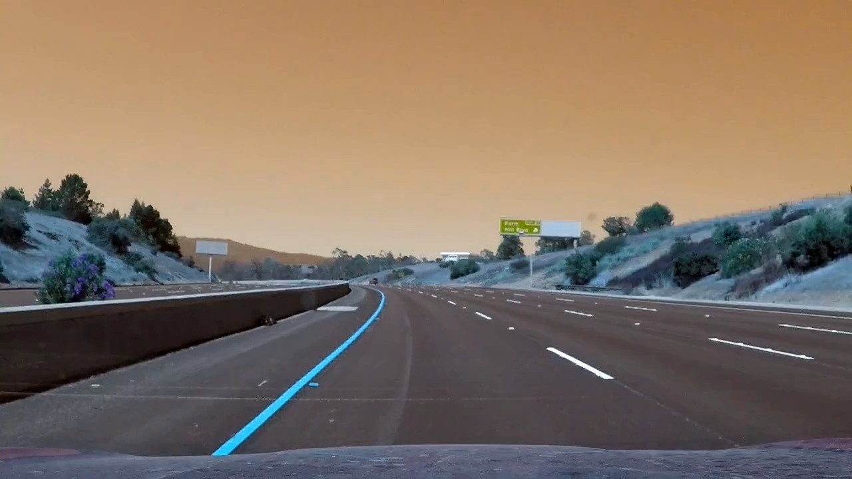
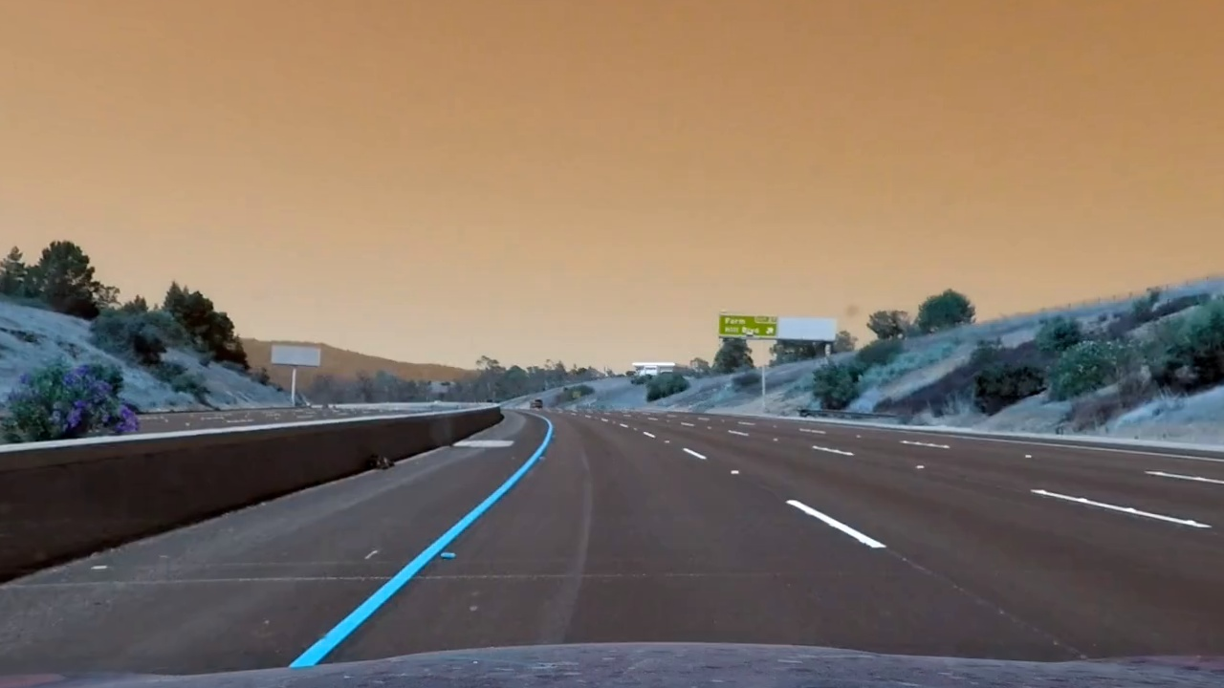
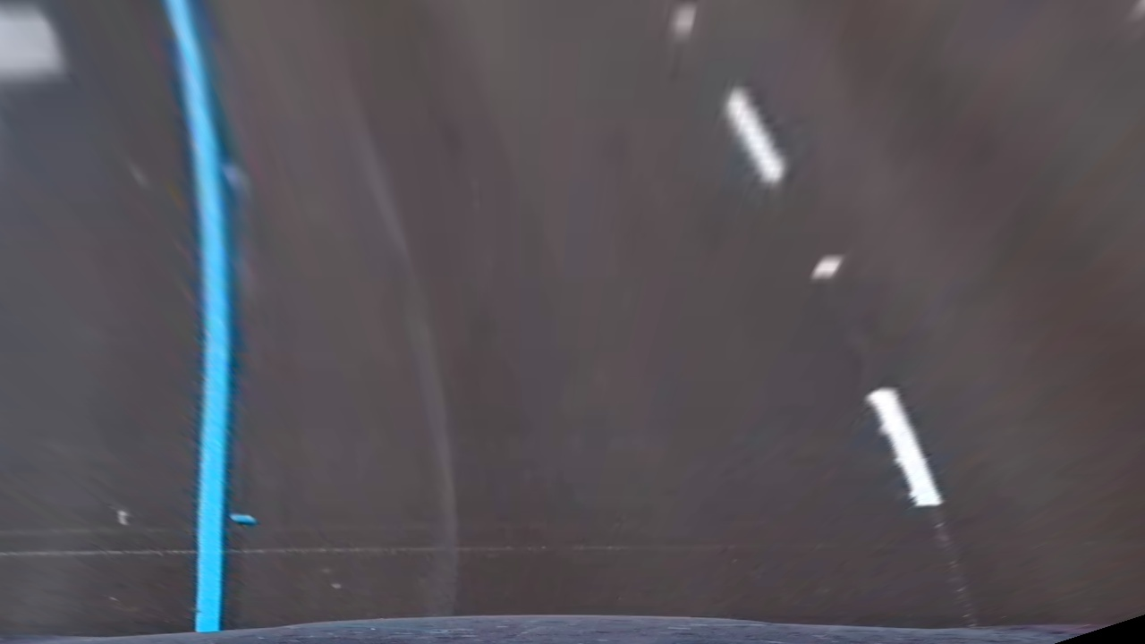
Modules – Lane Detection System (Visualisation)
Step -1
Creates a copy of the original image for visualization purposes.
Step -2
Undistorts the image using camera calibration parameters.
Step -3
Applies perspective transformation to obtain a bird's eye view of the road.

Slide 14
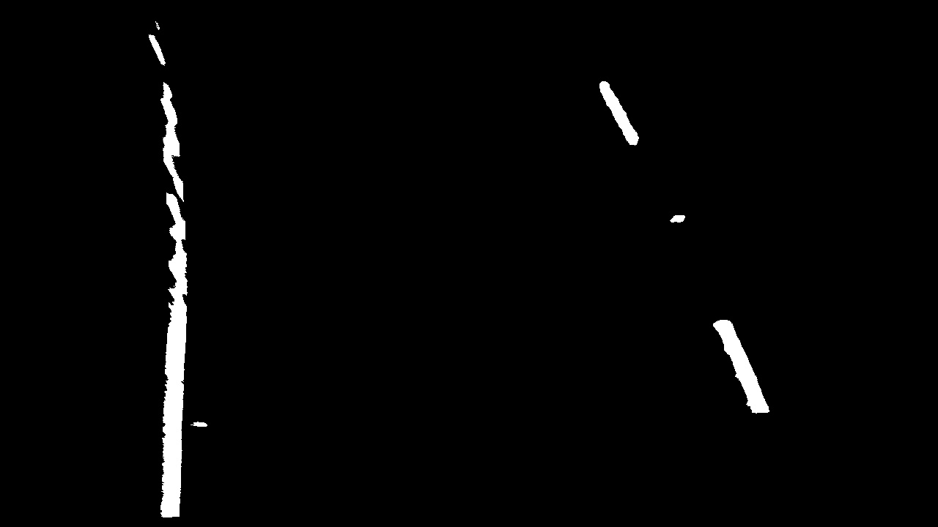


Modules – Lane Detection System (Visualisation)
Step -4
Performs thresholding to identify lane markings.
Step -5
Detects Lanes and draws lane lines on the image.
Step -6
Reverses perspective transformation to return to the original view.

Slide 15
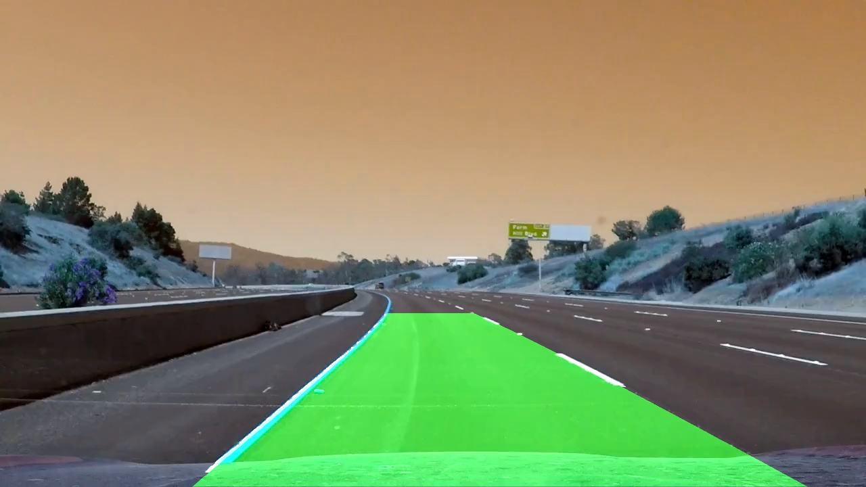
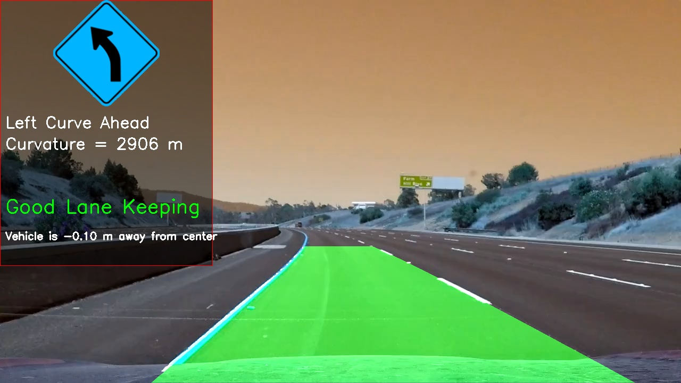
Modules – Lane Detection System (Visualisation)
Step -7
Blends the annotated lane lines with the original image.
Step -8
Overlays additional lane line information, such as curvature and vehicle position, on the image.

Slide 16
Modules – Lane Detection System (Overall Visualisation)

Slide 17
Modules – Pothole Detection System
Pothole Detection System consists of a Python module designed to interact with a PostgreSQL database to store and retrieve images related to pothole detection.
The module comprises two main functions: run_pothole_detection and view_screenshots.
Pothole Detection: The run_pothole_detection function utilizes the YOLO (You Only Look Once) object detection model to analyze a given video file for potholes. It processes each frame of the video, identifies potholes using YOLO, and stores frames containing detected potholes in the PostgreSQL database. Additionally, it establishes a connection to the database using psycopg2 and creates a table to store image data.
Screenshot Viewing: The view_screenshots function retrieves stored images from the database and presents them to the user for viewing. It connects to the PostgreSQL database, fetches image data along with associated IDs, and decodes the base64-encoded image data using NumPy and OpenCV. The function then prompts the user to input the number of images to display, displays the images using OpenCV, and handles any exceptions that may occur during the process.

Slide 18
Modules – Zebra Crossing and Traffic Signal Recognition System
The presented module orchestrates a real-time traffic management system, utilizing the YOLO object detection framework for identifying crucial elements within a video stream. It begins by loading a pre-trained YOLO model and capturing the input video stream. Subsequently, each frame undergoes resizing to match the model's input size.
YOLO predicts objects in the frames, with subsequent processing aimed at recognizing traffic signals, zebra crossings, and pedestrians. Upon detection, informative messages are overlaid onto the frames, guiding the driver accordingly. For instance, if a red traffic light is detected, a prompt to stop is displayed, while a green light prompts safe passage.
Moreover, the system advises slowing down upon detecting a zebra crossing or a yellow traffic light. Pedestrians crossing at zebra crossings are also accounted for, with encouragement to proceed when detected.
Finally, the processed frames, enriched with annotations and guidance, are written to an output video file. This module embodies a holistic approach to real-time traffic management, leveraging cutting-edge object detection techniques to enhance driver awareness and safety.

Slide 19
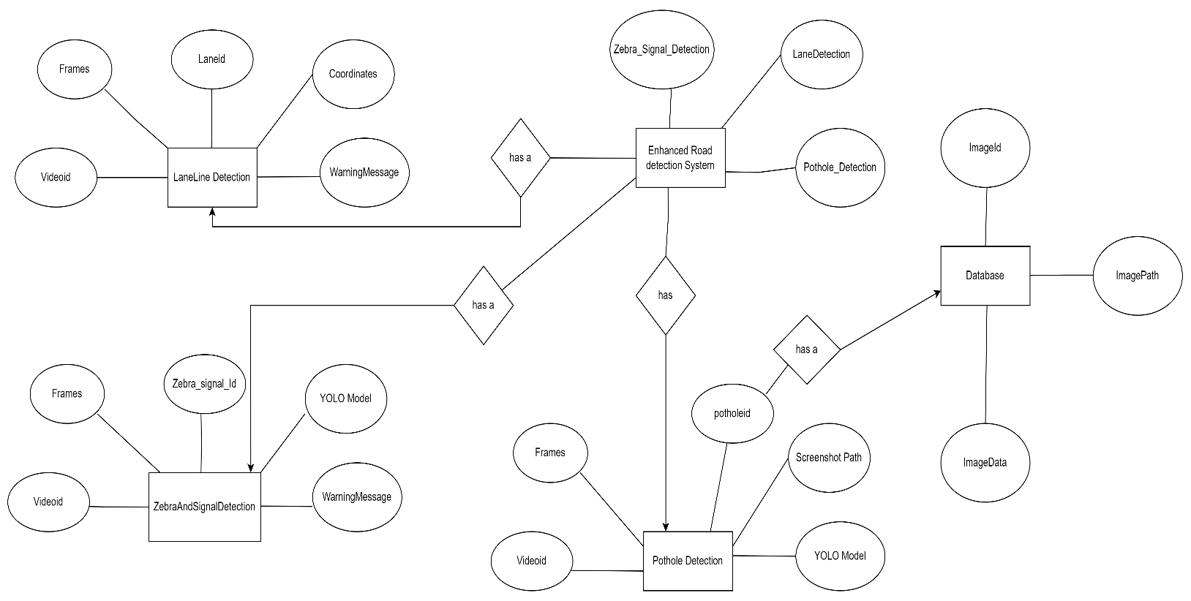
System Design - ERD And Normalization Diagram

Slide 20
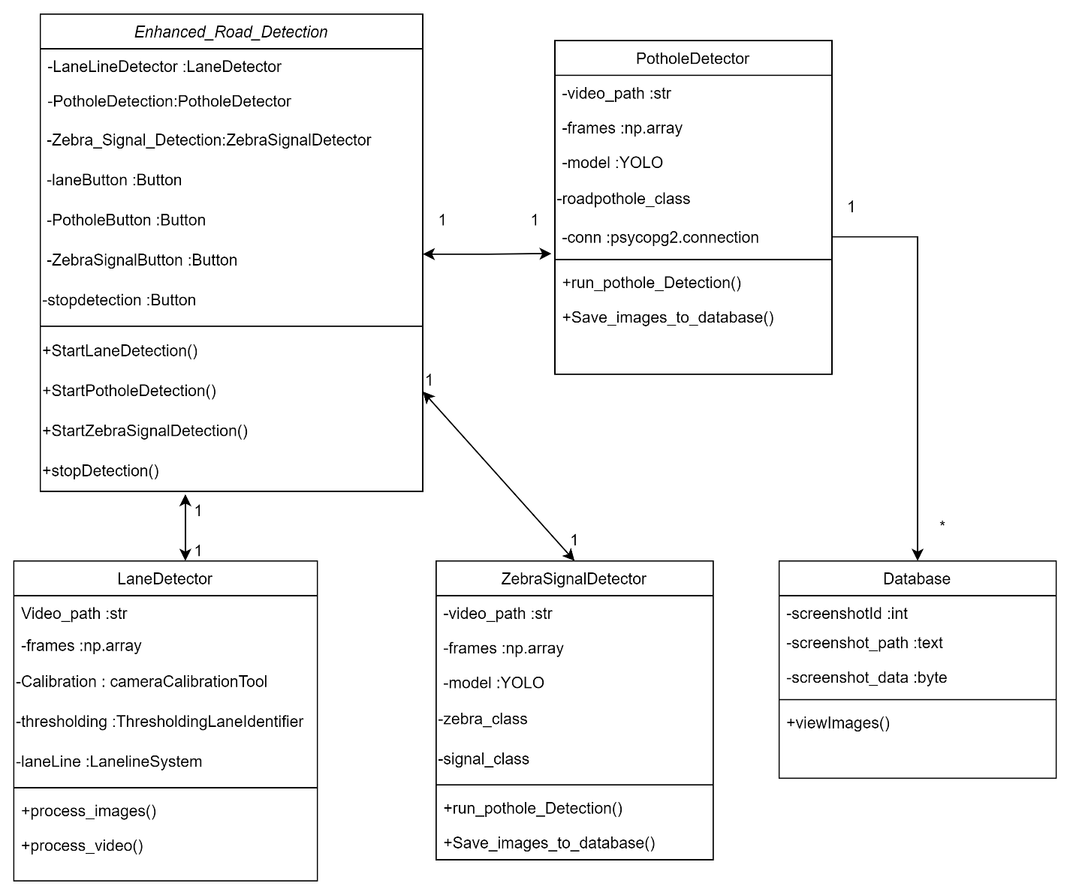
System Design - UML Diagram

Slide 21
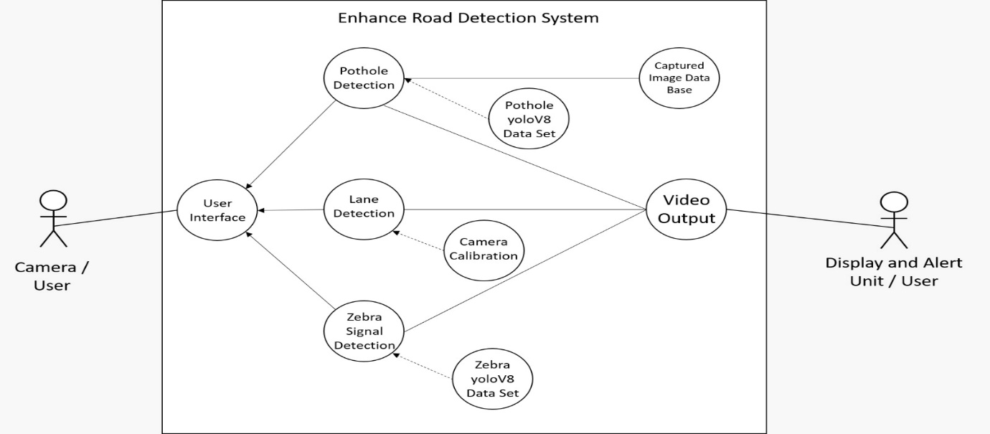
System Design - Use Case Diagram

Slide 22
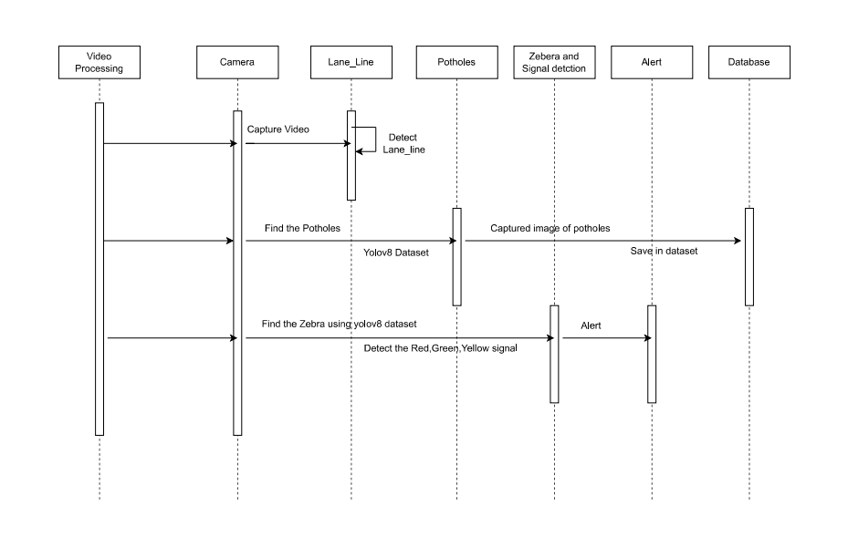
System Design - Sequence Diagram

Slide 23
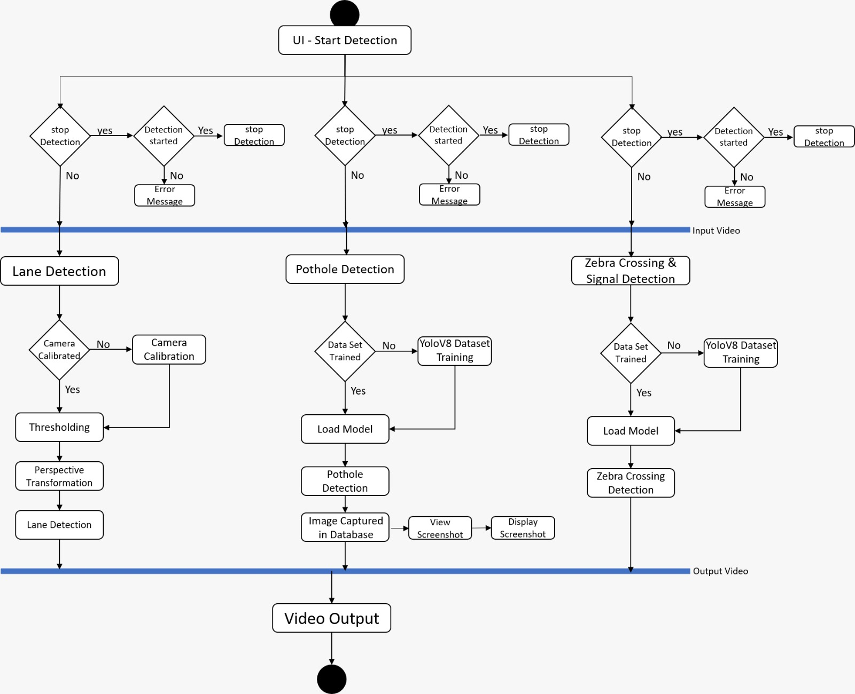
System Design - Activity Diagram

Slide 24
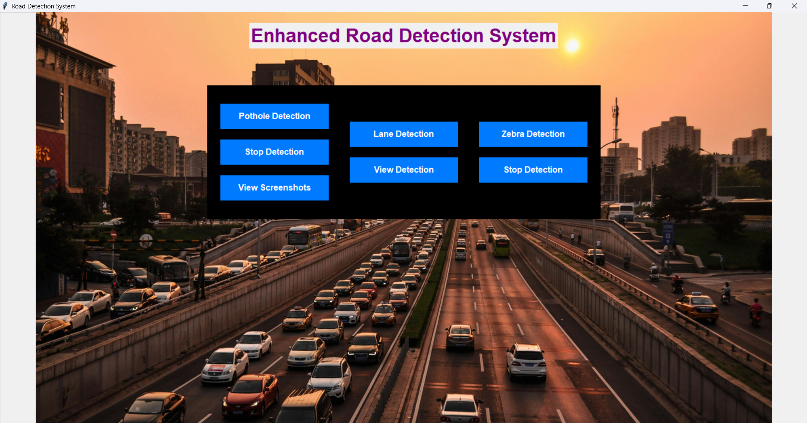
I/O Screens - User Interface

Slide 25
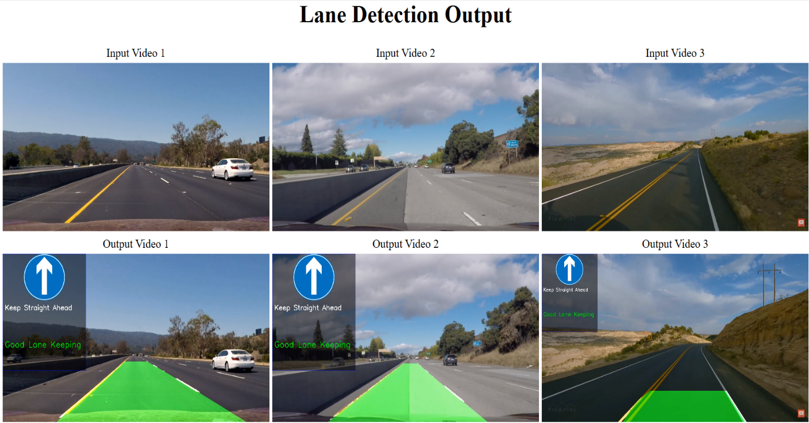
I/O Screens - Lane Detection Output Interface

Slide 26
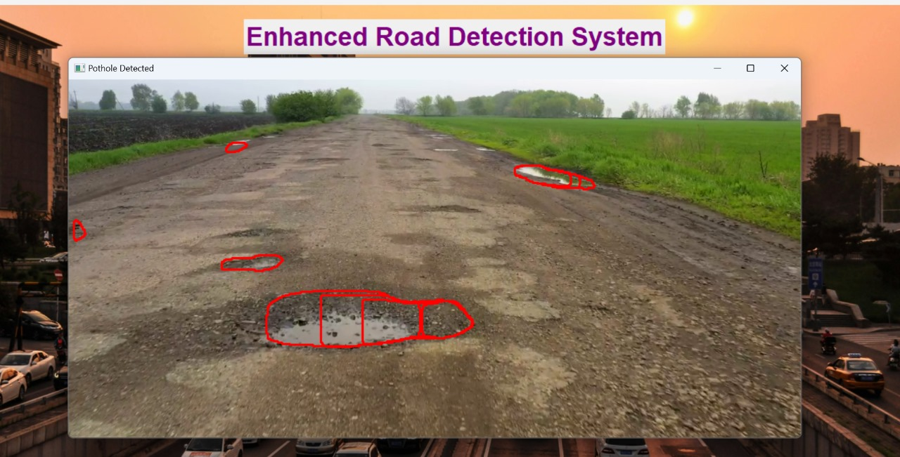
I/O Screens - Pothole Detection Output Interface

Slide 27
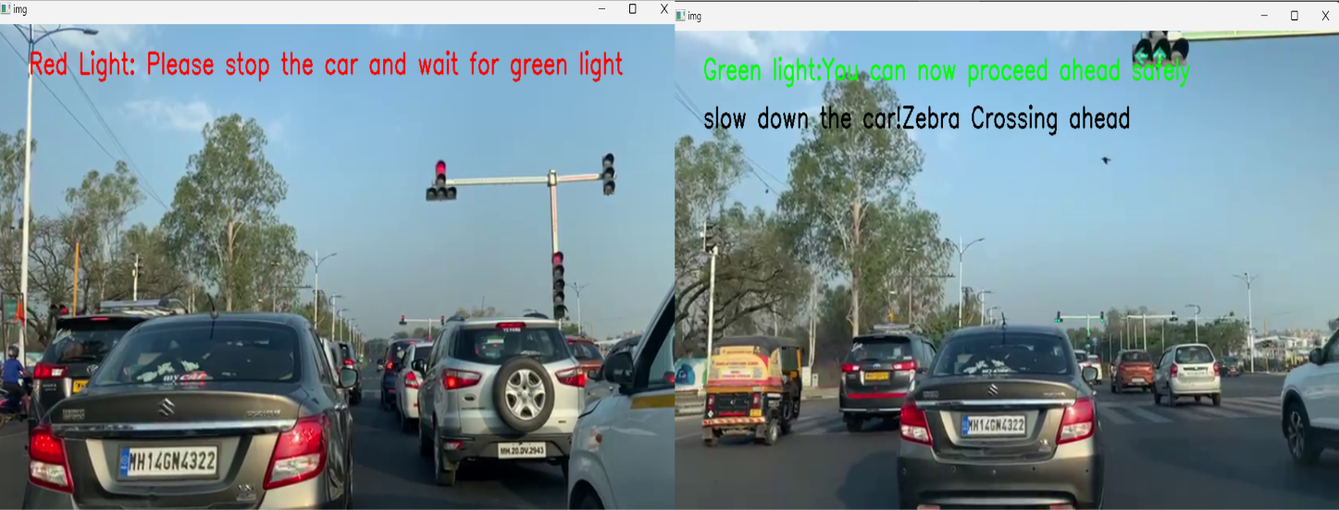
I/O Screens - Signal Detection Output Interface

Slide 28
Test Cases - Lane Line Detection System
Test Case Description: Lane Detection - Positive test case. A sample road video is used for lane detection. Pre-Requisite: The lane detection module (main.py) is installed and configured correctly. The necessary dependencies, including OpenCV, Matplotlib are installed.
Sr No | Action | Inputs | Test Case ID | Test Priority | Expected Output | Actual Output | Result | Comments
1 | Setup | - | LD-1 | High | Lane detection module and dependencies are properly configured. | Dependencies configured successfully. | Pass | Dependencies configured without errors
2 | Input Video Selection | Sample road video | LD-1 | High | A suitable sample road video is selected for testing. | Sample video selected successfully. | Pass | Sample video successfully loaded.
3 | Execution | Selected video | LD-1 | High | Lane detection module is executed with the sample video as input. | Lane lines detected successfully. | Pass | Lane lines detected accurately.
4 | Validation of Output | Detected lane lines | LD-1 | High | Detected lane lines are accurately overlaid on the original video. | Detected lane lines match ground truth markings. | Pass | Lane lines overlaid precisely on the original video.
5 | Assertion | Detected lane lines | LD-1 | High | Detected lane lines match the ground truth lane markings. | Assertion successful. | Pass | Ground truth lane markings matched by detected lines
6 | Feedback | Discrepancies/issues | LD-1 | High | Any discrepancies or issues observed during testing are documented. | No discrepancies found. | Pass | No discrepancies noted during testing
7 | Regression Testing | Multiple sample videos | LD-1 | High | Test is repeated with multiple sample videos for consistency. | Multiple videos tested successfully. | Pass | Regression testing ensured continued accurate detection of lane lines.

Slide 29
Test Cases - Pothole Detection System
Test Case Description: Pothole Detection - Positive test case. A sample road video is used for pothole detection.
Pre-Requisite: The pothole detection module (test.py) is installed and configured correctly. The necessary dependencies, including OpenCV and NumPy are installed.
Sr No | Action | Inputs | Test Case ID | Test Priority | Expected Output | Actual Output | Result | Comments
1 | Setup | - | PD-1 | High | Pothole detection module and dependencies are properly configured. | Dependencies configured successfully. | Pass | Dependencies configured smoothly.
2 | Input Video Selection | Sample road video | PD-1 | High | A suitable sample road video is selected for testing. | Sample video selected successfully. | Pass | Sample video input processed without issues.
3 | Execution | Selected video | PD-1 | High | Pothole detection module is executed with the sample video as input. | Potholes detected successfully. | Pass | Potholes detected effectively.
4 | Validation of Output | Detected potholes | PD-1 | High | Detected potholes are accurately marked or highlighted in the video. | Potholes marked correctly in the video. | Pass | Potholes marked accurately in the video.
5 | Assertion | Detected potholes | PD-1 | High | Detected potholes match the ground truth pothole locations. | Assertion successful. | Pass | Ground truth pothole locations matched by detected ones.
6 | Feedback | Discrepancies/issues | PD-1 | High | Any discrepancies or issues observed during testing are documented. | No discrepancies found. | Pass | Testing revealed no discrepancies or issues.

Slide 30
Test Cases - Zebra and Signal Detection System
Test Case Description: Zebra Crossing and Signal Detection - Positive test case. A sample road video is used for detecting zebra crossings and traffic signals.
Pre-Requisite: The Zebra and Signal detection module (zebra.py) is installed and configured correctly. The necessary dependencies, including OpenCV and NumPy are installed.
Sr No | Action | Inputs | Test Case ID | Test Priority | Expected Output | Actual Output | Result | Comments
1 | Setup | - | ZSD-1 | High | Zebra and signal detection modules and dependencies are properly configured. | Dependencies configured successfully. | Pass | Dependencies set up correctly.
2 | Input Video Selection | Sample road video | ZSD-1 | High | A suitable sample road video is selected for testing. | Sample video selected successfully. | Pass | Sample video selection completed successfully.
3 | Execution | Selected video | ZSD-1 | High | Zebra and signal detection modules are executed with the sample video as input. | Zebra and signals detected successfully. | Pass | Zebra crossings and signals detected with accuracy.
4 | Validation of Output | Detected zebra and signals | ZSD-1 | High | Detected zebra crossings and signals are accurately marked or highlighted in the video. | Zebra crossings and signals marked correctly in the video. | Pass | Zebra crossings and signals highlighted precisely in the video.
5 | Assertion | Detected zebra and signals | ZSD-1 | High | Detected zebra crossings and signals match the ground truth locations. | Assertion successful. | Pass | Detected zebra crossings and signals aligned with ground truth locations.
6 | Feedback | Discrepancies/issues | ZSD-1 | High | Any discrepancies or issues observed during testing are documented. | No discrepancies found. | Pass | No issues or discrepancies identified during testing.

Slide 31
Challenges
The Enhanced Road Detection System project faced difficulties since actual equipment was unavailable and computational power was constrained. It would have been easier to validate the system's dependability and performance if there had been real road infrastructure. The complexity and scale of the implemented algorithms were also limited by the limited processing capacity, requiring careful optimization to guarantee efficiency within hardware limitations.
Accumulating large enough and varied training datasets to train reliable machine learning models proved to be another major hurdle. The lack of sensor data and annotated road imagery made it difficult for the system to generalize successfully across various contexts and road conditions. In addition, obtaining extensive test datasets in a constrained amount of time created more time-bound requirements, requiring effective data collecting and validation techniques to fulfill project deadlines.

Slide 32
Limitation
Manual intervention is required to set up coordinates for lane line detection in each input video due to variations in camera setups. As the camera configuration may differ for each video, setting up the coordinates manually ensures accurate detection of lane lines.
The detection capabilities for potholes, lane lines, zebra crossings, and traffic signals are constrained by the size and diversity of the training datasets. Currently, the datasets used for training are relatively small, which can result in reduced accuracy and generalization capabilities, particularly in varied road conditions.

Slide 33
Future Scope
Advanced Detection Techniques: Explore and integrate advanced detection techniques such as 3D object detection to improve the accuracy and robustness of the detection systems.
Multi-Modal Sensing: Investigate the use of multi-modal sensing technologies, including LiDAR, radar, and infrared sensors, to complement visual-based detection systems and enhance their performance in challenging environmental conditions.
Dynamic Road Marking Detection: Develop algorithms capable of dynamically detecting and interpreting temporary road markings, construction zones, and lane diversions to provide timely alerts to drivers and improve road safety during construction activities.
Predictive Analytics: Incorporate predictive analytics capabilities to forecast potential road hazards, traffic congestion, and infrastructure maintenance needs based on historical data and real-time observations, enabling proactive intervention and planning.
Integration with Autonomous Vehicles: Explore opportunities to integrate the detection systems with autonomous vehicle platforms to enhance their perception capabilities and enable safer and more reliable autonomous driving in diverse road environments.

Slide 34
Conclusion
The development of the Enhanced Road Detection System signifies a significant leap forward in improving road safety and traffic management. By employing advanced computer vision algorithms and machine learning techniques, the project effectively tackles crucial challenges encountered on roads, including lane deviations, pothole hazards, pedestrian safety, and traffic regulation. Through subsystems like lane detection, pothole detection, and zebra crossing/traffic signal recognition, the project offers valuable insights and proactive measures to enhance overall road safety and efficiency.
Integration of these subsystems into a cohesive project lays the groundwork for a comprehensive Enhanced Road Detection System capable of detecting and addressing various road hazards in real-time. The project's success underscores the feasibility and effectiveness of leveraging cutting-edge technologies like computer vision and machine learning to address critical issues in road safety and traffic management, promising safer and smoother journeys for all road users.

Slide 35
Bibliography & References
https://app.roboflow.com/potholesproject-afkvq/pothole_detection-lragw/settings
https://app.roboflow.com/shraddha-pansare-0hlpi/yolov8-ozdbl/settings
https://docs.opencv.org/4.x/d6/d00/tutorial_py_root.html
https://numpy.org/doc/
https://matplotlib.org/stable/api/image_api.html
https://ipython.readthedocs.io/en/stable/api/generated/IPython.display.html
https://pypi.org/project/moviepy/
https://docs.opencv.org/4.x/dc/dbb/tutorial_py_calibration.html
https://docs.python.org/3/library/glob.html
https://docs.python.org/3/library/tk.html

